Slide 1
Vision Transformer
汇报人：汪俊彦

Slide 2
An Image is Worth 16x16 Words: Transformers for Image Recognition at Scale
Alexey Dosovitskiy, Lucas Beyer, et.al.
Google Research, Brain Team
ICLR 2021
arXiv: 2010.11929

Slide 3
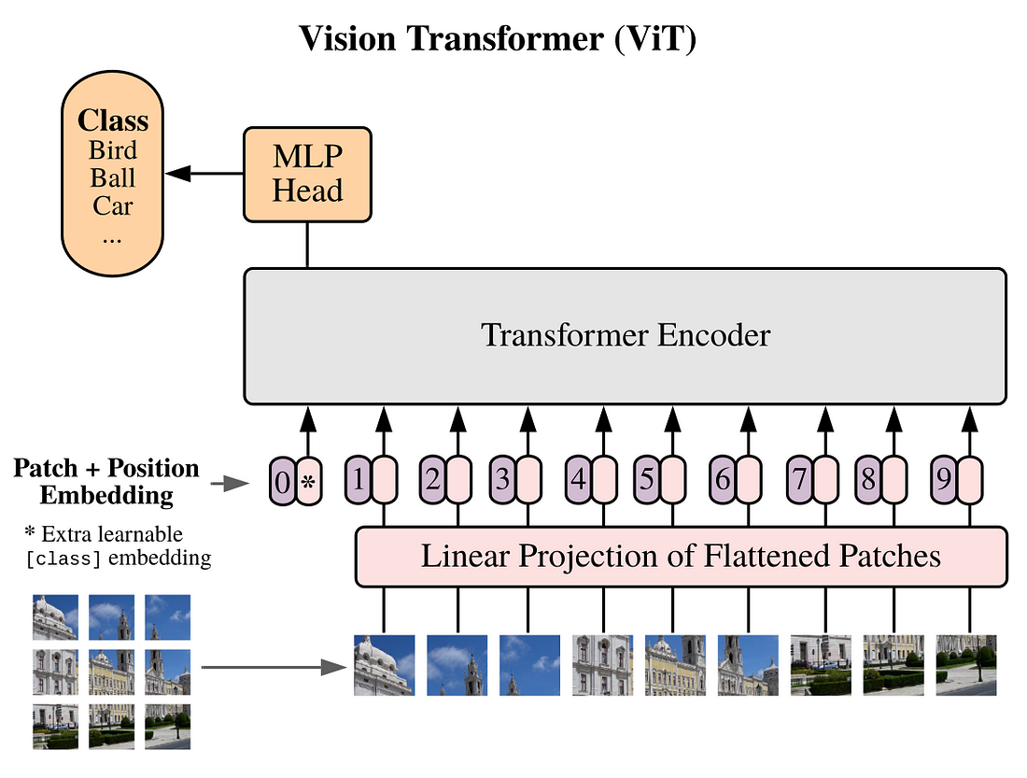
ViT结构
Patch Embedding
Position Embedding
CLS token
Transformer Encoder
MLP Head

Slide 4
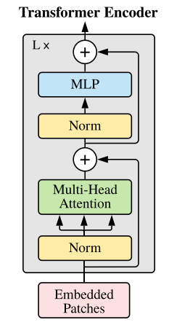
Transformer Encoder
Norm = LayerNorm
Multi-Head Attention
MLP

Slide 5
Patch Embedding
将图像转成序列

Slide 6
CLS Token & Position Embedding
Position Embedding
用比不用好
咋用差别不大
注意：不同的选择方式，对于学习率十分敏感。

Slide 7
Batch Normalization VS Layer Normalization

Slide 8
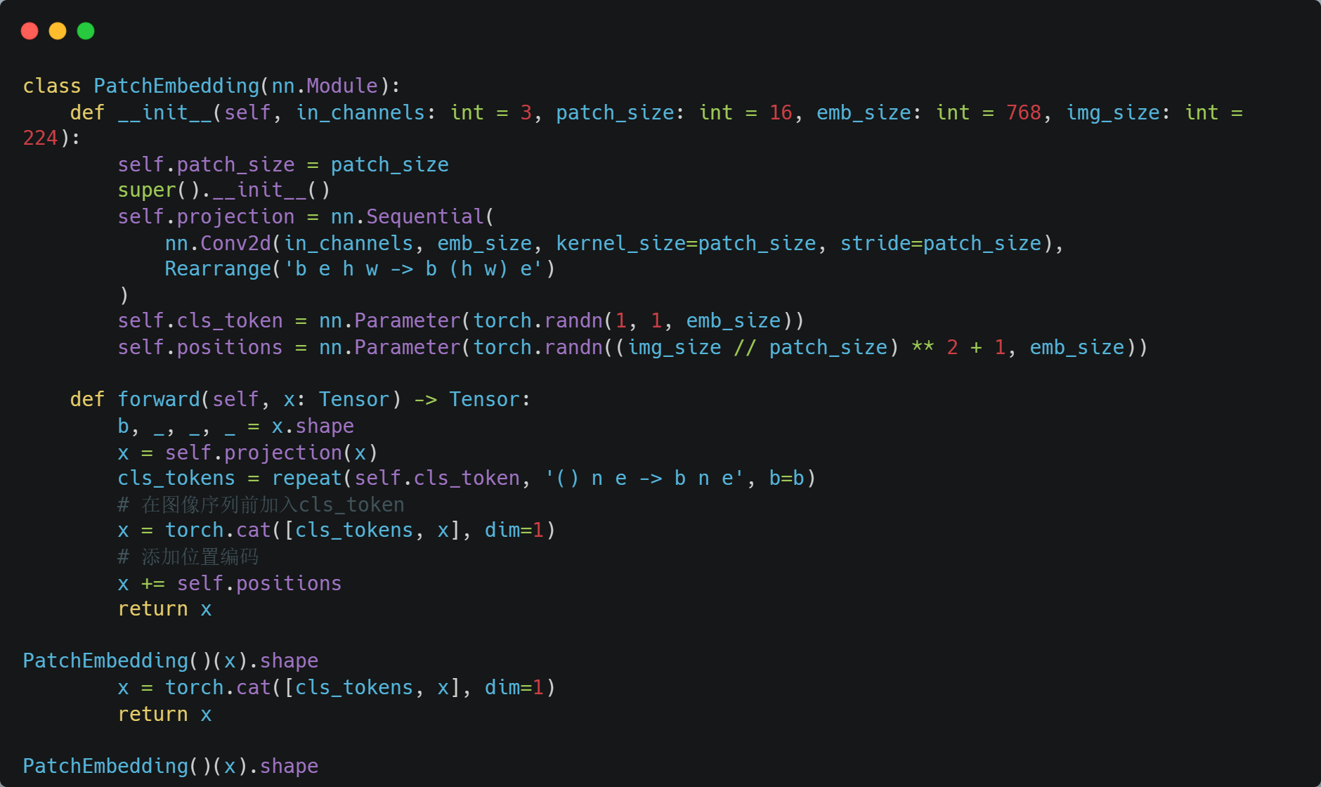
The Code of Above

Slide 9
Self Attention

Slide 10
Self Attention

Slide 11
Multi-head Self-attention

Slide 12
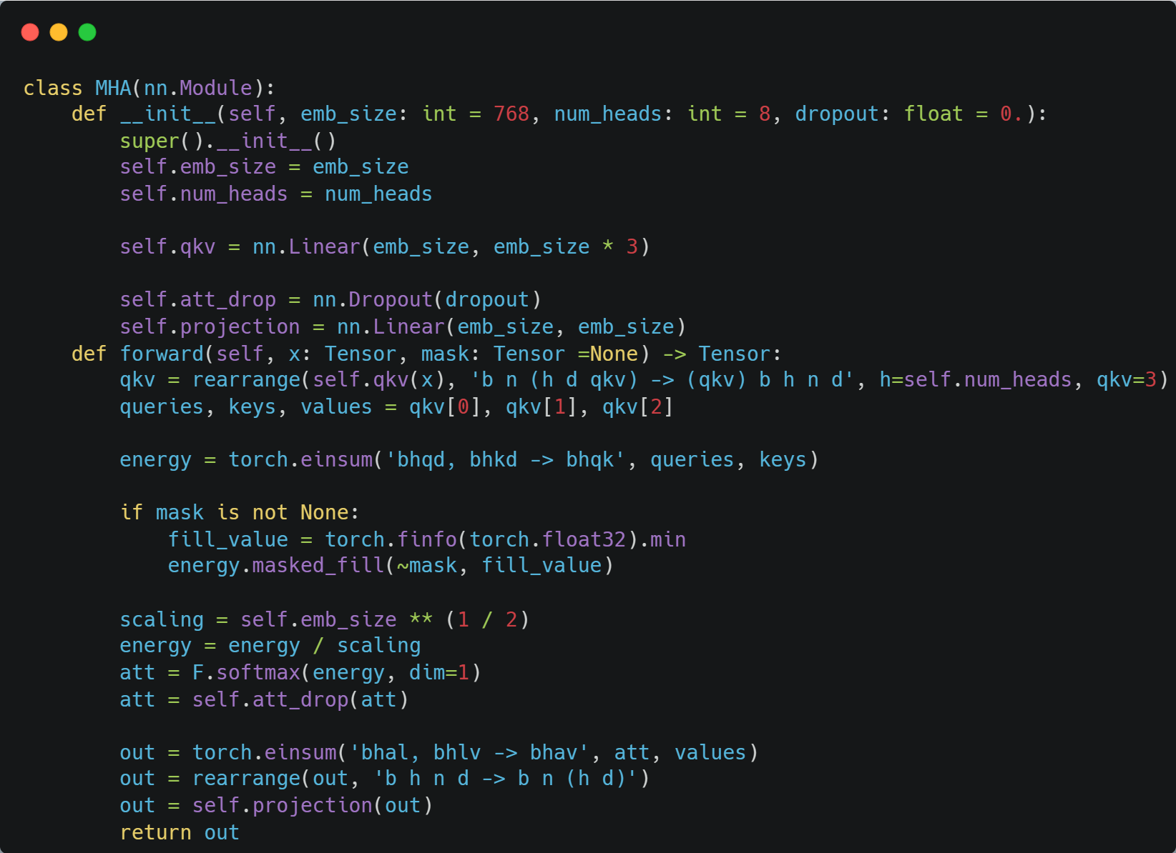
The Code of MHSA

Slide 13
Encode MLP = FeedForward

Slide 14
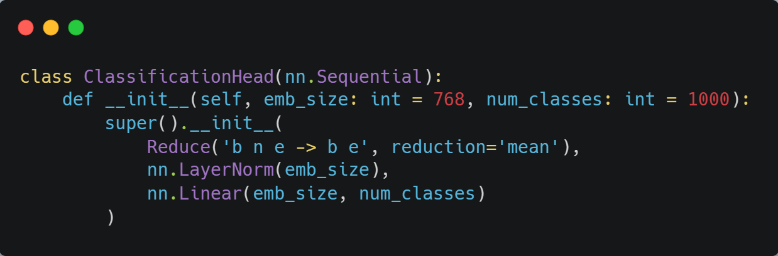
The Code of ClassificationHead

Slide 15
Training data-efficient image transformers & distillation through attention
Hugo Touvron, Matthieu Cord, et.al.
Facebook AI & Sorbone University
ICML 2021

Slide 16
论文核心
纯的Transformer；不使用外部数据；仅ImageNet-1K；Top-1 Acc 85.2%.
蒸馏；教师模型：CNN＞Transformer(相似性能)
ImageNet预训练模型；下游任务（细粒度分类）

Slide 17
Data-efficient image Transformers(DeiT)
与ViT区别：
Distillation token
训练策略

Slide 18
Soft distillation vs Hard-label distillation

Slide 19
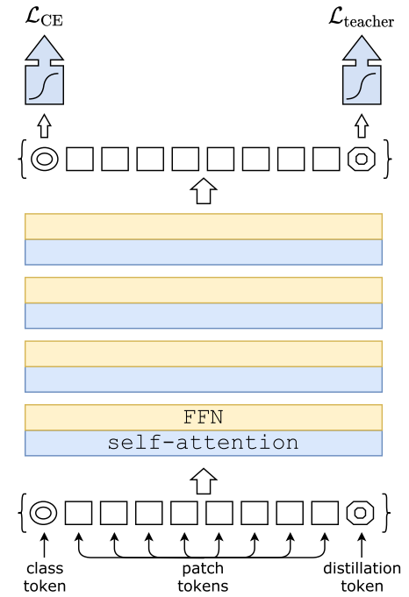
简单的示意

Slide 20
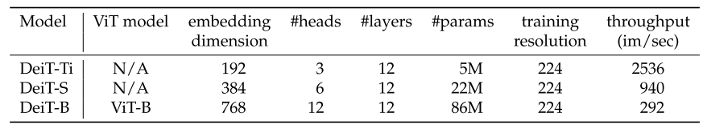
DeiT architecture

Slide 21
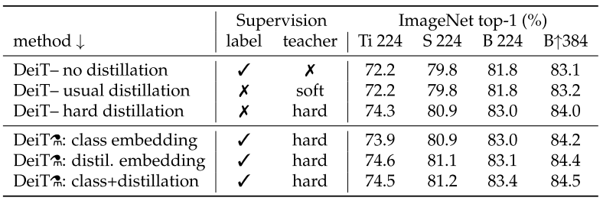
Distillation
CNN更加适合做为教师模型。
更多的epochs更有利于Distillation.

Slide 22
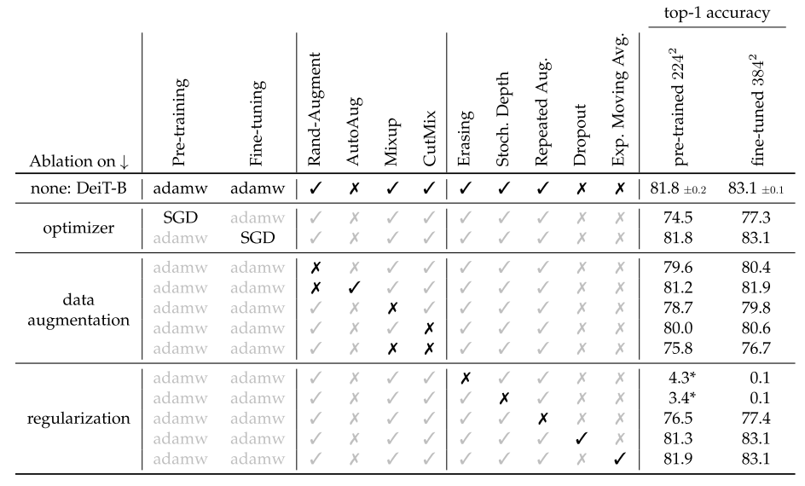
Training details
224*224上预训练，384*384上微调。
小分辨率预训练，大分辨率微调是可行的。

Slide 23
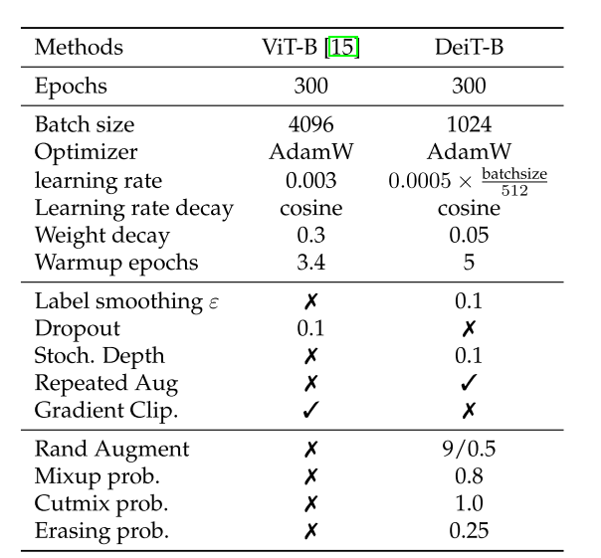
与ViT训练过程对比

Slide 24
Swin Transformer: Hierarchical Vision Transformer using Shifted Windows
Ze Liu, Yutong Lin, Yue Cao, Han Hu et.al.
Microsoft Research Asia
ICCV 2021 Marr Prize
arXiv:2103.14030

